Slide 1
WAN Connections
Enabling RIP

Slide 2
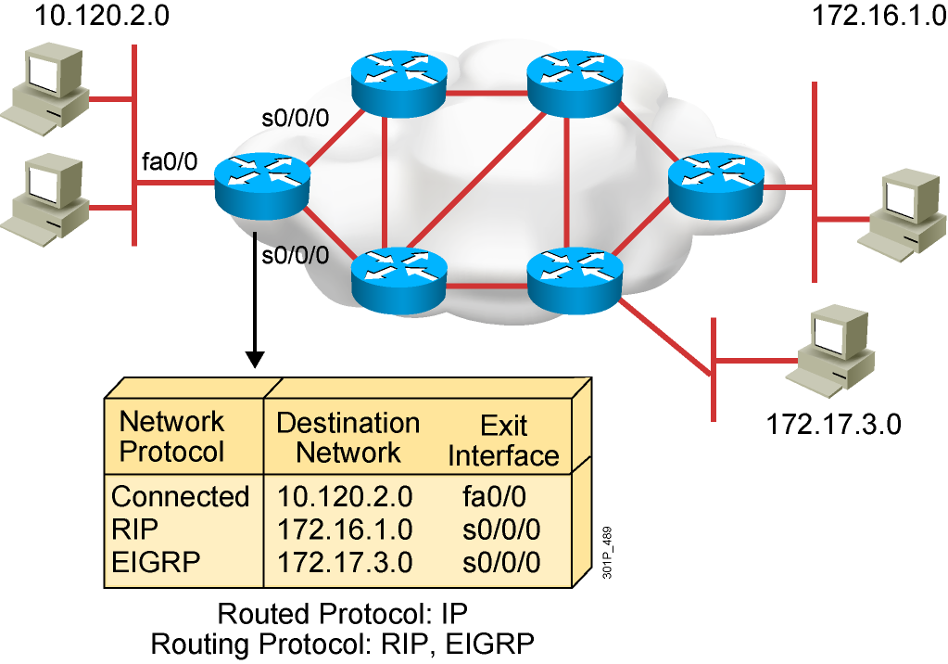
What Is a Routing Protocol?
  Routing protocols are used between
  routers to determine paths and maintain routing tables.
  After the path is determined, a router can route a routed protocol.
Notes:
Purpose: This figure introduces students to routing protocols and compares routing protocols to routed protocols.
Emphasize: If network 10.120.2.0 wants to know about network 172.16.2.0, it must learn it from its S0 (or possibly S1) interface.
Note: The two routing protocols that will be taught in this course are RIP and IGRP. They are both distance vector routing protocols.

Slide 3
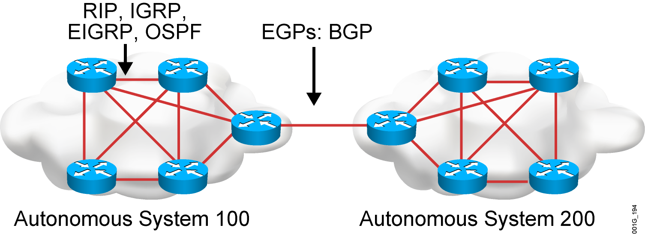
Autonomous Systems: Interior or Exterior Routing Protocols
  An autonomous system is a collection of networks under a common administrative domain.
  IGPs operate within an autonomous system.
  EGPs connect different autonomous systems.
Notes:
Purpose: This figure discusses autonomous systems, IGPs and EGPs.
Emphasize: Introduce the interior/exterior distinctions for routing protocols, as follows:
Interior routing protocols are used within a single autonomous system
Exterior routing protocols are used to communicate between autonomous systems
The design criteria for an interior routing protocol require it to find the best path through the network. In other words, the metric and how that metric is used is the most important element in an interior routing protocol.
Exterior protocols are used to exchange routing information between networks that do not share a common administration. IP exterior gateway protocols require the following three sets of information before routing can begin:
A list of neighbor (or peer) routers or access servers with which to exchange routing information
A list of networks to advertise as directly reachable
The autonomous system number of the local router

Slide 4
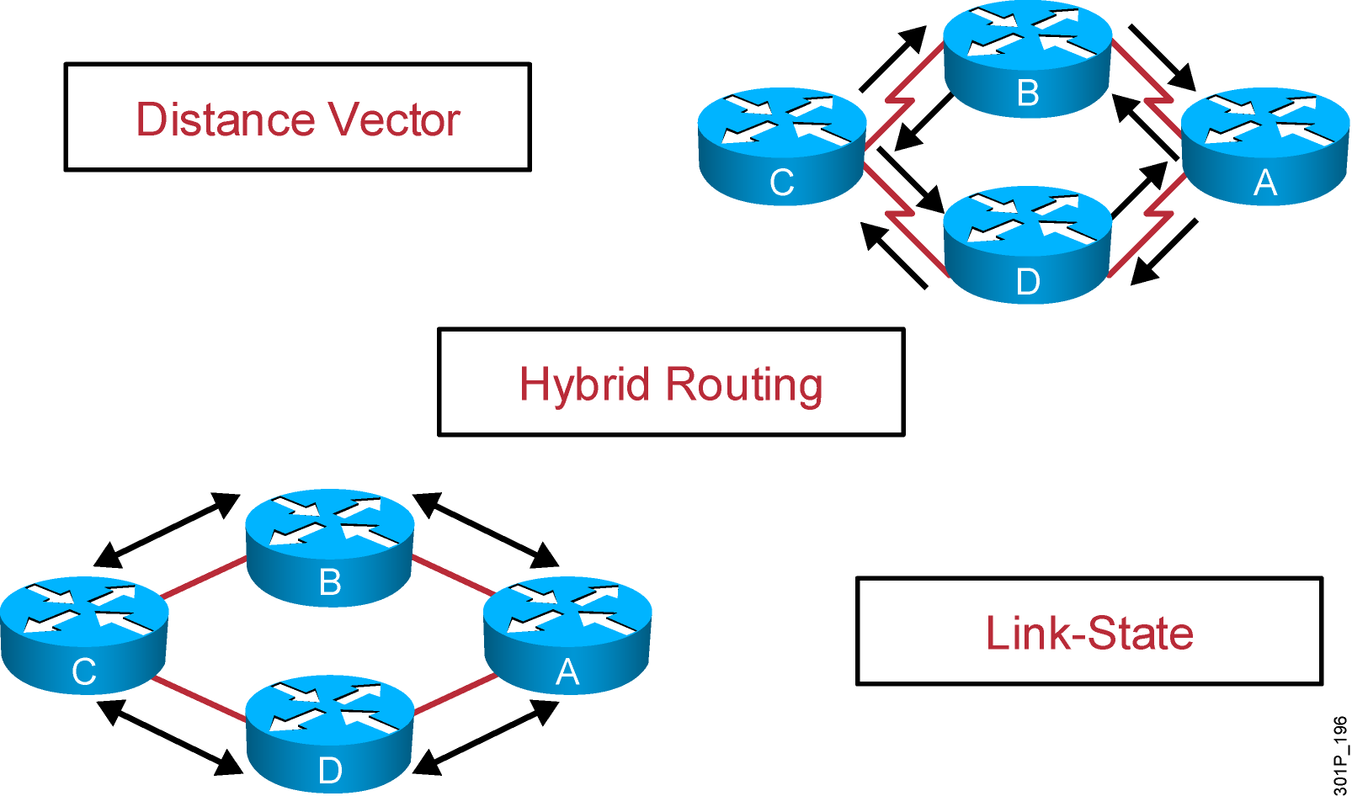
Classes of Routing Protocols
Notes:
Purpose: This figure introduces the three classes of routing protocols.
Emphasize: There is no single best routing protocol.
Note: Distance vector routing protocol operation is covered in detail later in this course. Link state and hybrid are only briefly explained after the distance vector discussion. Refer students to the ACRC to learn more about link-state and hybrid routing protocols.

Slide 5
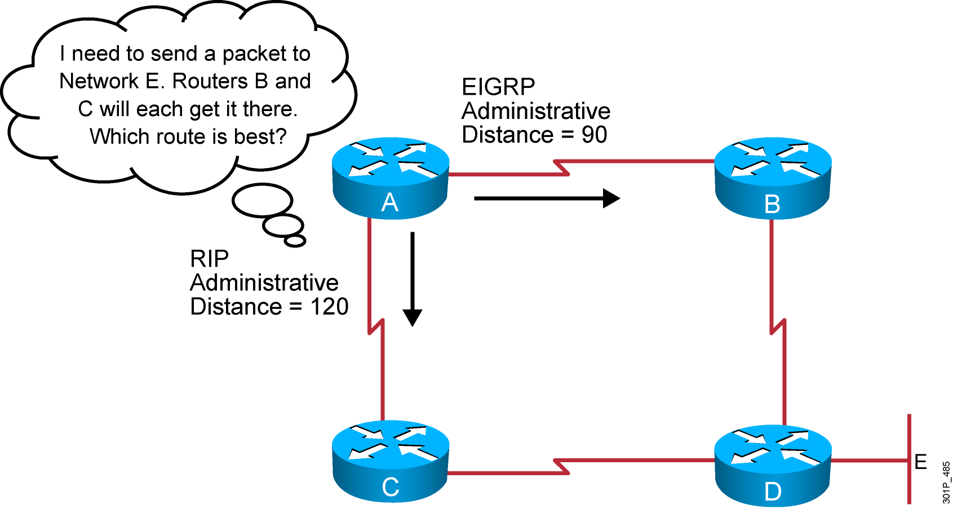
Administrative Distance:
Ranking Routes
Notes:
5
Purpose: This figure introduces administrative distance.
Emphasize: An administrative distance is a rating of the trustworthiness of a routing information source, such as an individual router or a group of routers. In a large network, some routing protocols and some routers can be more reliable than others as sources of routing information.
The default administrative distance for static routes and various routing protocols is listed in the Student Guide. The lower the distance, the more trustworthy the route is. For example, in the figure, the packet would learn the route learned via IGRP.

Slide 6
Classful Routing Protocol
  Classful routing protocols do not include the subnet mask with the route advertisement.
  Within the same network, consistency of the subnet masks is assumed.
  Summary routes are exchanged between foreign networks.
  These are examples of classful routing protocols:
    RIPv1
    IGRP

Slide 7
Classless Routing Protocol
  Classless routing protocols include the subnet mask with the route advertisement.
  Classless routing protocols support a variable-length subnet mask (VLSM).
  Summary routes can be manually controlled within the network.
  These are examples of classless routing protocols:
    RIPv2
    EIGRP
    OSPF
    IS-IS

Slide 8
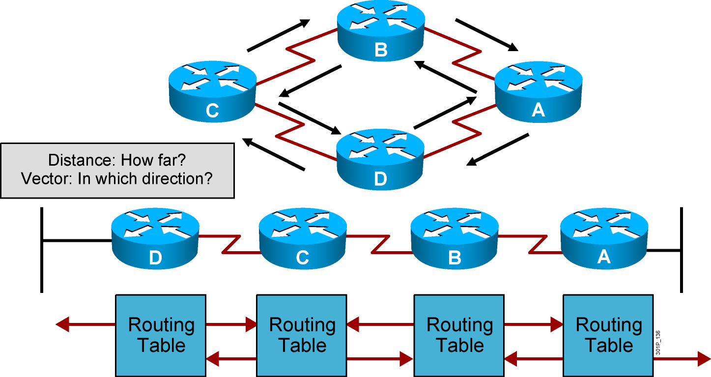
Distance Vector Routing Protocols
  Routers pass periodic copies of their routing table to neighboring
  routers and accumulate distance vectors
Notes:
Purpose: This figure introduces the distance vector routing algorithm, the first of the classes of routing protocols, and outlines how it operates.
Emphasize: Distance vector algorithms do not allow a router to know the exact topology of an internetwork.
This information is somewhat analogous to the information found on signs at a highway intersection. A sign points toward a road leading away from the intersection and indicates the distance to the destination.
Further down the highway, another sign also points toward the destination, but now the distance to the destination is shorter.
As long as each successive point on the path shows that the distance to the destination is successively shorter, the traffic is following the best path.

Slide 9
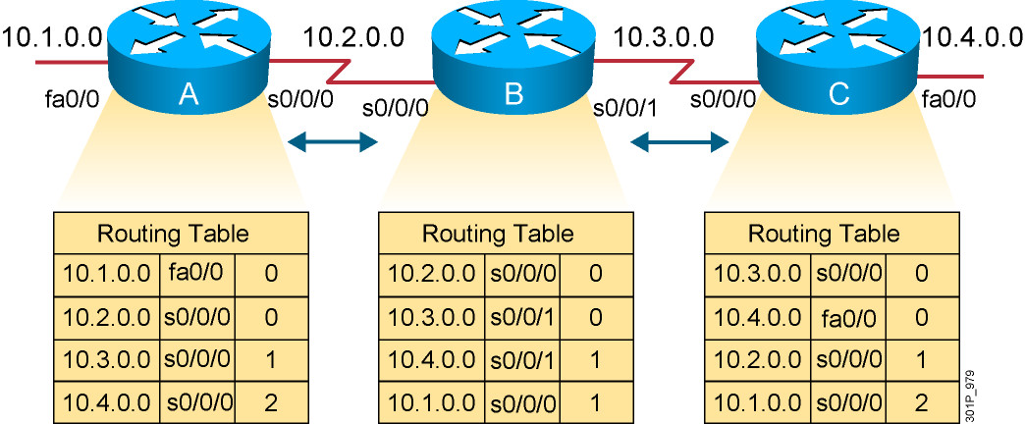
Sources of Information and Discovering Routes
  Routers discover the best path to destinations from each neighbor.
Notes:
Layer 3 of 3
Emphasize: Layer 3 adds the final entries received some time later that have distances of 2 from routers A and C.

Slide 10
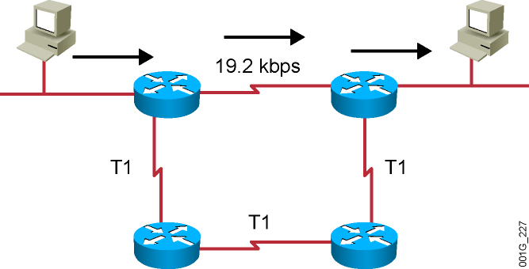
RIP Overview
  Maximum is 16 equal-cost paths (default = 4)
  Hop-count metric selects the path
  Routes update every 30 seconds
Notes:
Purpose: This figure presents general information about RIP.
Emphasize: The figure shows a network. The arrows highlight the path RIP selects. RIP selects the best path based on the shortest hop count, so it ignores the path with the faster T1 links.
Be sure that you do not disparage RIP. It was developed in a homogeneous network. If everything is connected via a single media type, then bandwidth-based metrics reduce to hop count. In some cases, RIP is more appropriate than other protocols. It is extremely well tested.

Slide 11
RIPv1 and RIPv2 Comparison
 | RIPv1 | RIPv2
Routing protocol | Classful | Classless
Supports variable-length subnet mask? | No | Yes
Sends the subnet mask along with the routing update? | No | Yes
Addressing type | Broadcast | Multicast
Defined in … | RFC 1058 | RFCs 1721, 1722, and 2453
Supports manual route summarization? | No | Yes
Authentication support? | No | Yes
Notes:
Purpose: This figure presents general information about RIP.
Emphasize: The figure shows a network. The arrows highlight the path RIP selects. RIP selects the best path based on the shortest hop count, so it ignores the path with the faster T1 links.
Be sure that you do not disparage RIP. It was developed in a homogeneous network. If everything is connected via a single media type, then bandwidth-based metrics reduce to hop count. In some cases, RIP is more appropriate than other protocols. It is extremely well tested.

Slide 12
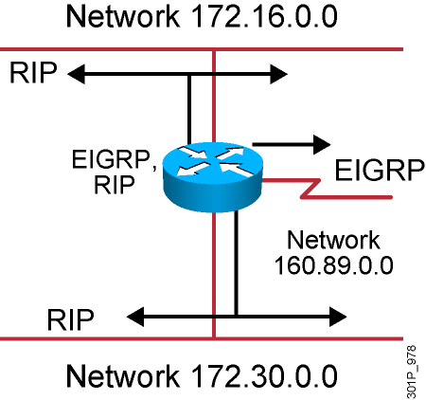
IP Routing Configuration Tasks
  Router configuration
    Select routing protocols
    Specify networks or interfaces
Notes:
Purpose: This figure defines the tasks needed to configure IP routing.
Emphasize: This is a general overview of tasks, so the graphic shows both IGRP and RIP in the protocol box.
Tell your students that the router is able to route using both RIP and IGRP. It is possible to run IGRP and RIP concurrently. The IGRP information will override the RIP information by default because of IGRP’s administrative distance.
However, running IGRP and RIP concurrently does not work well when the network topology changes. Because IGRP and RIP have different update timers, and because they require different amounts of time to propagate routing updates, one part of the network may end up believing IGRP routes and another part may end up believing RIP routes. This will result in routing loops.
Review the fundamentals of router-configuration and interface-configuration modes.
Transition: The command to enable dynamic routing follows.

Slide 13
RIP Configuration
RouterX(config)# router rip
  Starts the RIP routing process
RouterX(config-router)# version 2
  Enables RIP version 2
RouterX(config-router)# network network-number
  Selects participating attached networks
  Requires a major classful network number
Notes:
Purpose: This figure presents the Cisco IOS™ commands used to configure RIP.
Emphasize: The figure shows the router rip command and the network network-number command. A proper understanding of these commands will save many problems in the lab.
Point out that the network statement contains no subnetting information.
Networks are directly connected and are specified as a Class A, B, or C network number.
Transition: An example of configuration follows.

Slide 14
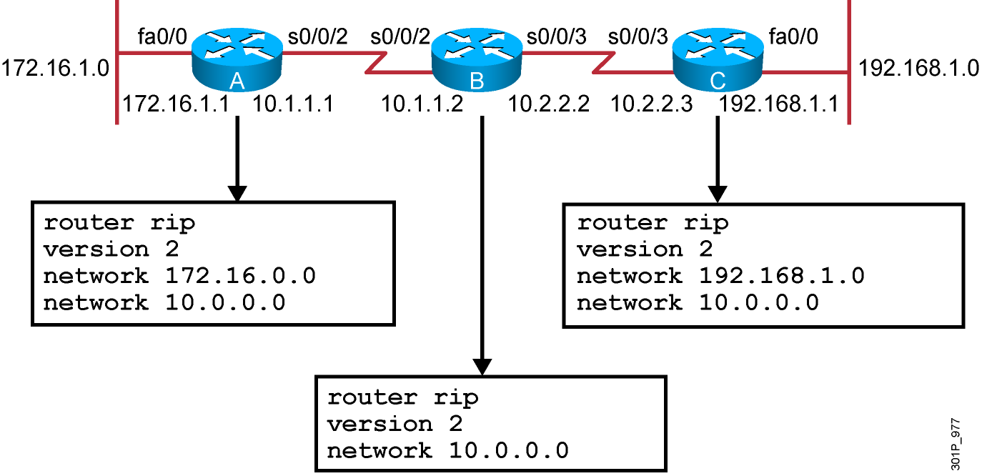
RIP Configuration Example
Notes:
Purpose: The figure shows how the RIP commands operate on the example network.
Emphasize: An administrator only specifies directly connected networks that should be published to other routers.
Without the network command, nothing is advertised. With a network command, the router will advertise every subnet within the Class A, B, or C network specified in the configuration.

Slide 15
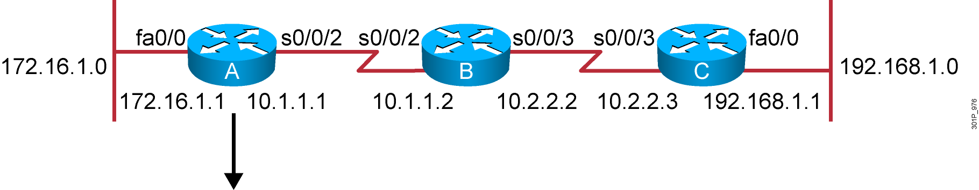
Verifying the RIP Configuration
Routing Protocol is "rip"
Sending updates every 30 seconds, next due in 6 seconds
Invalid after 180 seconds, hold down 180, flushed after 240
Outgoing update filter list for all interfaces is not set
Incoming update filter list for all interfaces is not set
Redistributing: rip
Default version control: send version 2, receive version 2
Interface Send Recv Triggered RIP Key-chain
FastEthernet0/0 2 2
Serial0/0/2 2 2
Automatic network summarization is in effect
Maximum path: 4
Routing for Networks:
10.0.0.0
172.16.0.0
Routing Information Sources:
Gateway Distance Last Update
10.1.1.2 120 00:00:25
Distance: (default is 120)
RouterA#
Notes:
Purpose: This figure shows how the show ip protocol command is used to monitor RIP operation.
Emphasize: The command displays the routing protocols that are active on the router for IP. It also gives network and timer information.
Point out the timing information.
Point out the list of networks for which the router is injecting routes.
Point out the administrative distance metric.

Slide 16
Displaying the IP Routing Table
RouterA# show ip route
Codes: C - connected, S - static, I - IGRP, R - RIP, M - mobile, B - BGP
D - EIGRP, EX - EIGRP external, O - OSPF, IA - OSPF inter area
N1 - OSPF NSSA external type 1, N2 - OSPF NSSA external type 2
E1 - OSPF external type 1, E2 - OSPF external type 2, E - EGP
i - IS-IS, L1 - IS-IS level-1, L2 - IS-IS level-2, * - candidate default
U - per-user static route, o - ODR
T - traffic engineered route
Gateway of last resort is not set
172.16.0.0/24 is subnetted, 1 subnets
C 172.16.1.0 is directly connected, fastethernet0/0
10.0.0.0/24 is subnetted, 2 subnets
R 10.2.2.0 [120/1] via 10.1.1.2, 00:00:07, Serial0/0/2
C 10.1.1.0 is directly connected, Serial0/0/2
R 192.168.1.0/24 [120/2] via 10.1.1.2, 00:00:07, Serial0/0/2
Notes:
Purpose: This figure displays the show ip route command, which displays the contents of the router’s IP routing table.
Emphasize: Discuss the IP routing table in detail. Show the locations of the hop count (metric) and the administrative distance (120).
Discuss the following fields:
R—Refers to routes learned from RIP.
via—Refers to the router that informed us about this route.
00:00:07 timer value—RIP updates are every 30 seconds. Ask, “How long until the next update?”
The interfaces used for the best path

Slide 17
debug ip rip Command
RouterA# debug ip rip
RIP protocol debugging is on
RouterA#
00:06:24: RIP: received v1 update from 10.1.1.2 on Serial0/0/2
00:06:24: 10.2.2.0 in 1 hops
00:06:24: 192.168.1.0 in 2 hops
00:06:33: RIP: sending v1 update to 255.255.255.255 via FastEthernet0/0 (172.16.1.1)
00:06:34: network 10.0.0.0, metric 1
00:06:34: network 192.168.1.0, metric 3
00:06:34: RIP: sending v1 update to 255.255.255.255 via Serial0/0/2 (10.1.1.1)
00:06:34: network 172.16.0.0, metric 1
Notes:
Purpose: This figure shows the debug ip rip command.
Emphasize: Explain that debug commands also provide information for monitoring IP.
The first highlighted line lists the source of the updates. The router returned information about two destinations.
The last highlighted line shows the broadcast address to which the router sent updates.

Slide 18
Summary
  Routing is the process by which items get from one location to another.
  Dynamic routing protocols determine how updates are conveyed, what knowledge is conveyed, when to convey knowledge, and how to locate recipients of the updates.
  A routing protocol that has a lower administrative value is more trustworthy than a protocol that has a higher administrative value.
  There are three classes of routing protocols: distance vector, link-state, and balanced hybrid.
  The ip classless command can be used to prevent a router from dropping a packet that is destined for an unknown subnetwork of a directly attached network if a default route is configured.
Notes:
Purpose: This slide discuss the initial configurations on the routers and switches.
Note: There is no setup mode on the Catalyst 1900 switch.

Slide 19
Summary (Cont.)
  RIP is a distance vector routing protocol that uses hop count as the matrix for route selection and broadcasts updates every 30 seconds.
  RIPv1 uses classful routing protocol; RIPv2 uses classless routing protocol. RIPv2 supports VLSM, manual route summarization, and authentication; RIPv1 does not support these activities.
  To enable a dynamic routing protocol, first a routing protocol is selected, then IP network numbers are assigned without values being specified (except OSPF).
  The router command starts the routing process. The network command allows the routing process to determine which interfaces will participate in sending and receiving the routing updates.
Notes:
Purpose: This slide discuss the initial configurations on the routers and switches.
Note: There is no setup mode on the Catalyst 1900 switch.

Slide 20
Summary (Cont.)
  The router RIP command selects RIP as the routing protocol. The network command identifies a participating attached network.
  The show ip command displays information about routing protocols and the routing table.
  The debug ip rip command displays information on RIP routing transactions.
Notes:
Purpose: This slide discuss the initial configurations on the routers and switches.
Note: There is no setup mode on the Catalyst 1900 switch.

